Slide 1

CREDIT ADMINISTRATOR TRAINING

Slide 2
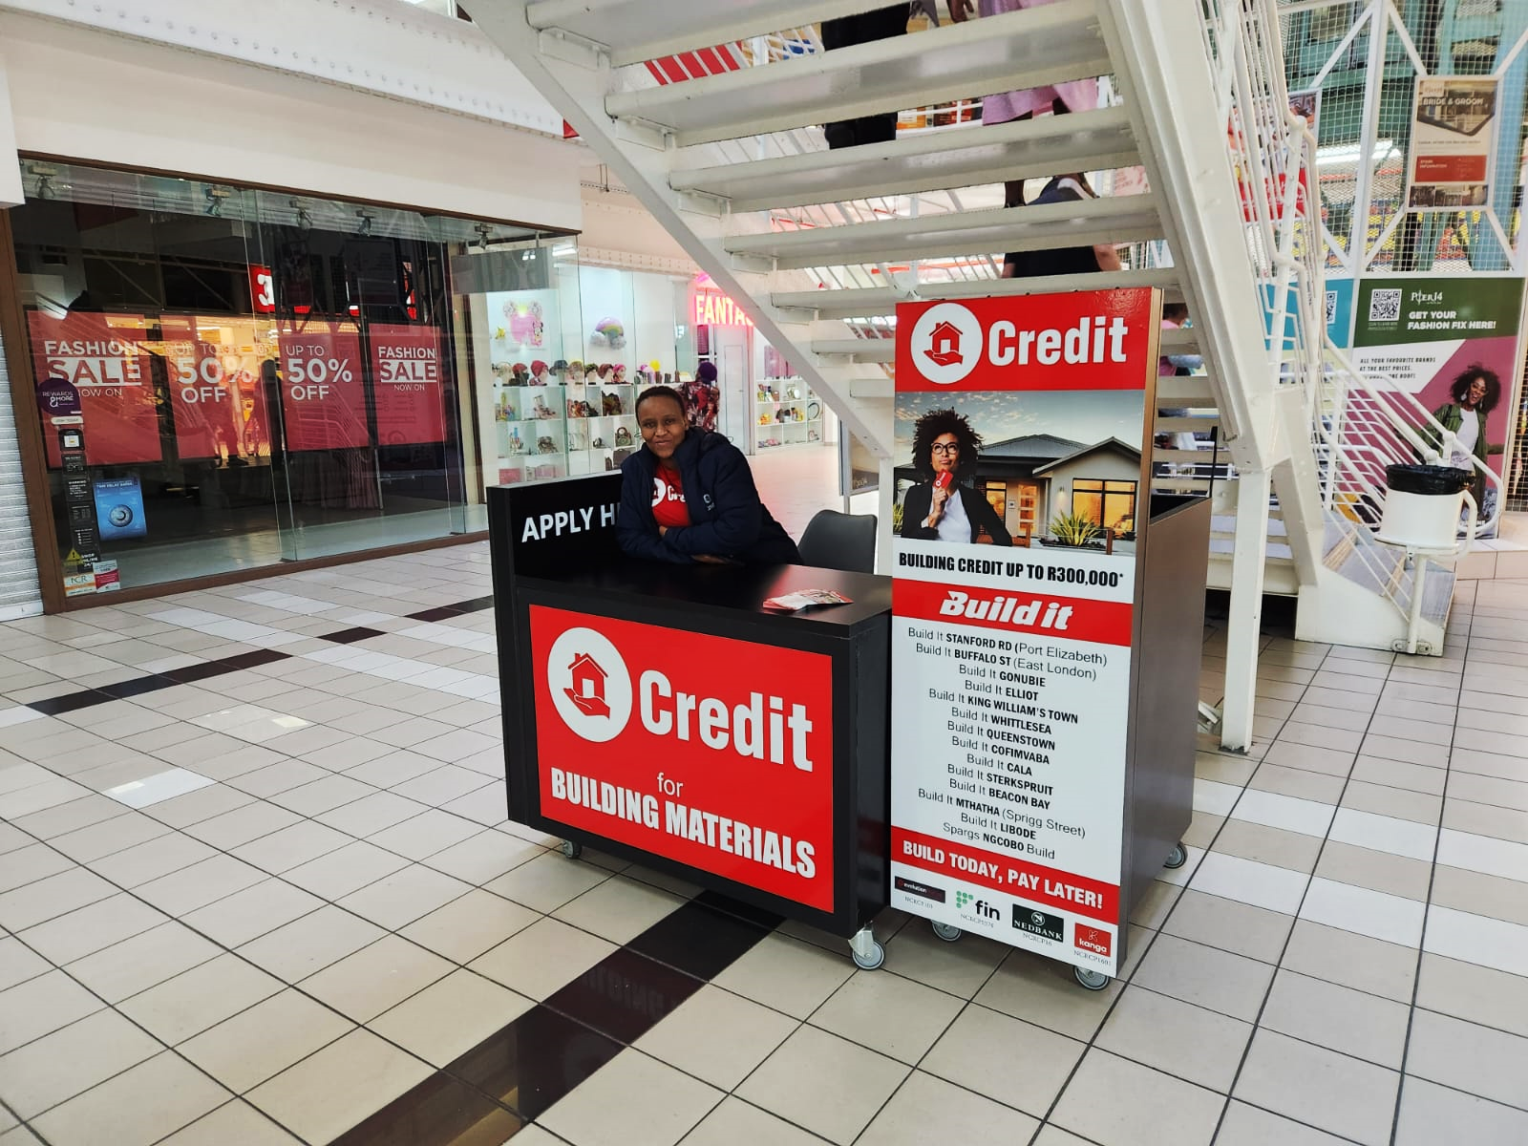
What is a Credit Administrator?
A Credit Administrator is someone that is responsible for
distributing marketing material,
explaining the product which is credit for (building material at hardware store),
processing credit applications for clients looking to build,
verifying client documentation, submitting and finalising offers at hand.

Slide 3
Tutibuzz Pty Ltd
Head Office
LENDERS
Nedbank
Evolution
Finance
Kanga
CREDIT ADMINISTRATOR
CUSTOMERS
Employed
Self-employed
Pensioners
Build It
Hardware Store

Slide 4
What is the role of a Credit Administrator?
Representing Build It in a professional manner
Managing the Credit Kiosk
Promoting and marketing the Build It finance division outside the store
Processing all credit applications
Liaising with the Credit clients, the hardware store staff and the lenders
Handling all other administrative tasks necessary to service the Credit clients

Slide 5
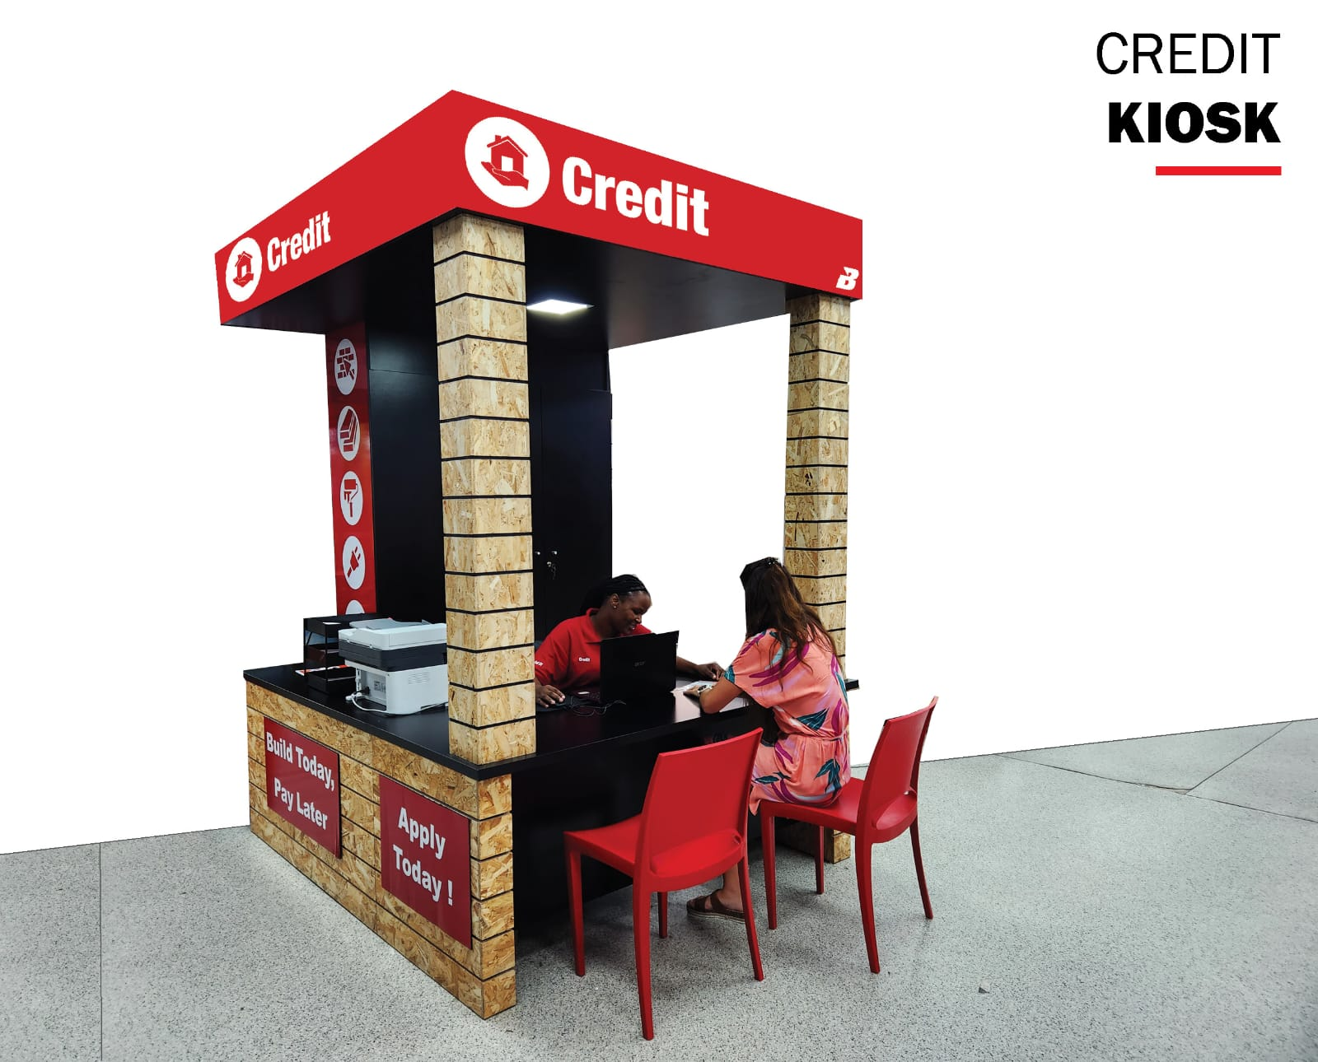
What does managing the Credit kiosk mean?
This means you’re responsible for maintaining the kiosk, it’s cleanliness, not leaving client documentation unattended or lying around.
Always keeping the lights on.
Everything kept where it’s supposed to be , and every time you are leaving your desk , ensure everything is locked away and nothing is lying around.
No one else has access in your kiosk except for you.

Slide 6
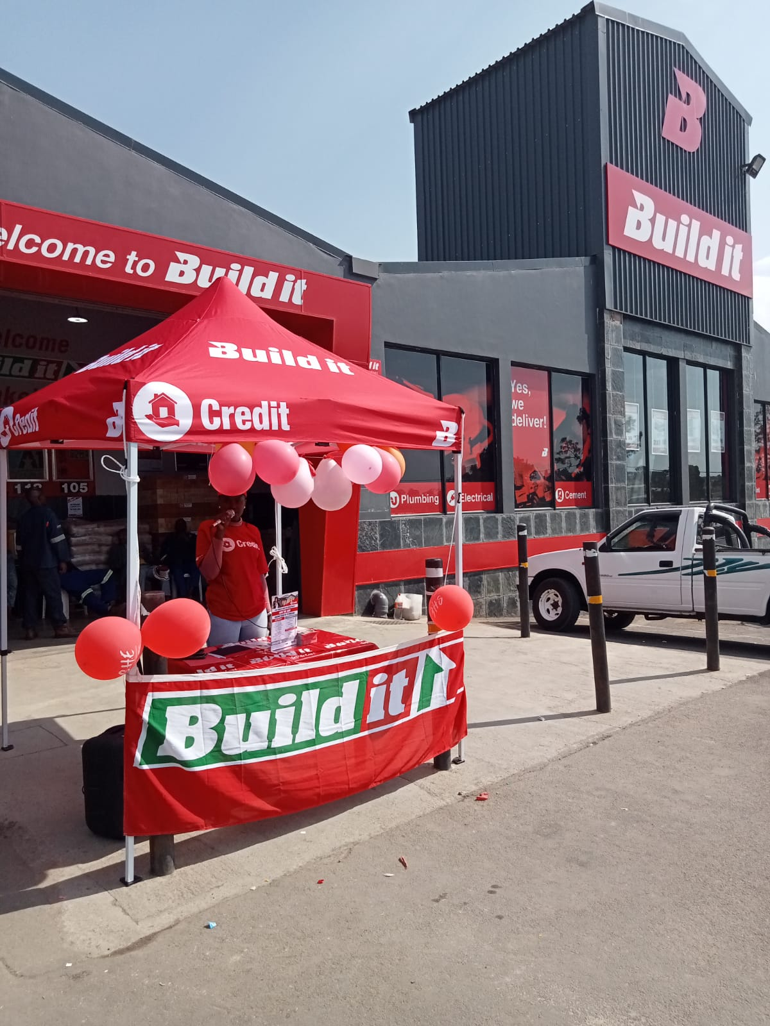
What does it meant to represent BUILD IT in a professional manner?
This means now that you’re part of the Build It team who should communicate effectively , ethical, be productive (focus on your job responsibilities) which in turn means avoiding browsing on your personal phone.
Develop a professional image this means dressing appropriately (in a company uniform allocated to you).
Develop self-awareness - learn to manage your emotions as this is your working environment and therefore requires for you to be positive and have a good attitude for people around you.
Build relationships – Network with colleagues , customers to build professional, cordial relationships.

Slide 7
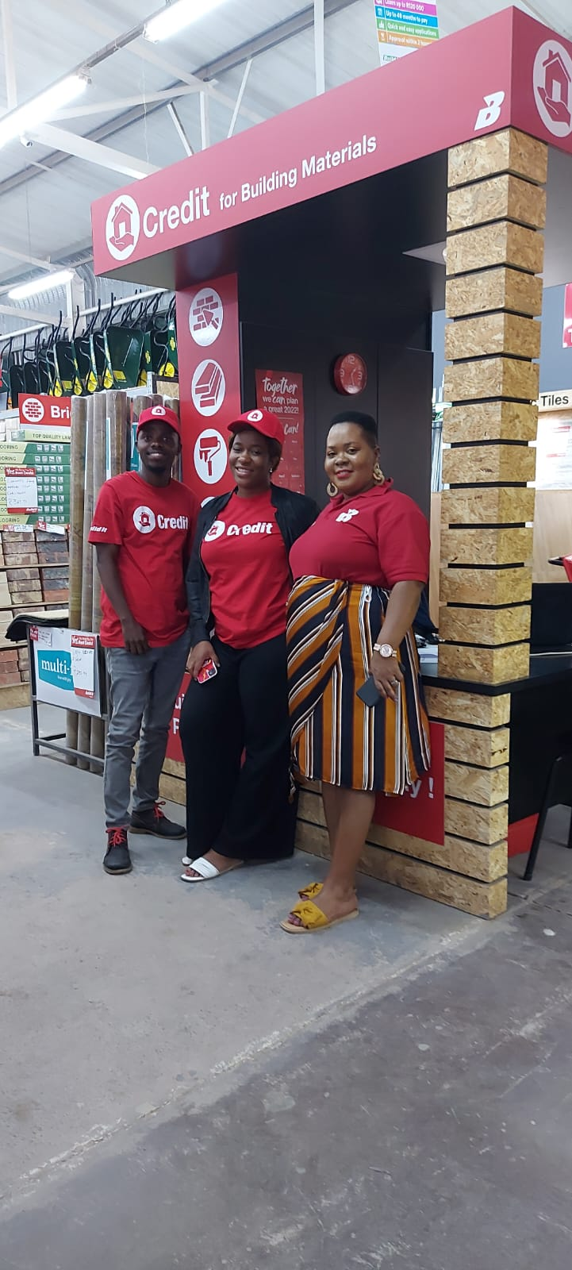
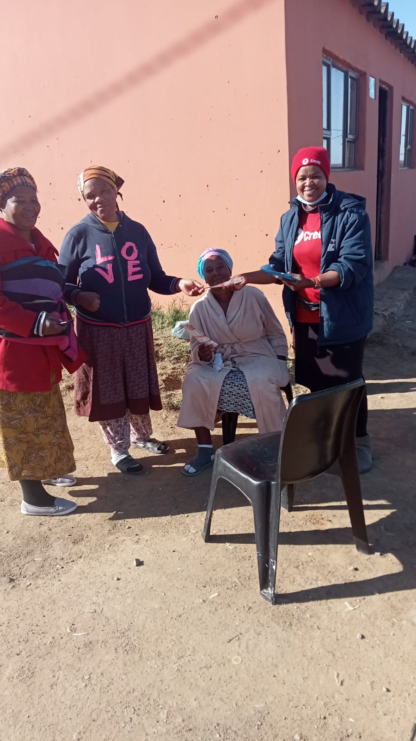
Promoting and marketing the BUILD IT Finance division inside and outside the store
When there’s no one being assisted at the Kiosk, take time and market the product inside the store and around the store area.
Go in detail when explaining the product, and ensure to ask the right questions to the customers.

Slide 8
Processing Credit Applications
Before the application process begins, ensure all appropriate/ correct/ required documentation is received.
Prepare info sheet which is made available on your browser and ensure all questions on it are answered properly to ensure a smooth customer service with the customer.
Find the suitable lenders to apply on.
Start the capturing process.
Present the offer to the client.
And finalise the deal accordingly, do follow-ups until deal gets paid out.
Inform client on what to do when deal gets paid out:
when the money is paid by the lender to the hardware store, credit admin then send an email to credit H/O cc store manager,
H/O then loads client credit card according to card number sequence inserted by the credit admin,
a unique pin is then sent to the client’s phone and credit admin needs to inform to keep this pin safe as they will be using it every time they shop and they cannot shop anywhere else with the card except for where they opened the account.
NB: On Payout - UPDATE ALL SHEETS ACCORDINGLY ( Lead sheet, Info sheet and Status report)

Slide 9
Find out what the customer NEEDS
ASK THE QUESTIONS:
- WHAT are they looking for,
- WHERE are they building,
- HOW MUCH do they need
Acquire REQUIRED DOCUMENTATION from the customer.
Prepare an INFO SHEET for the customer.
PROCESS THE APPLICATION accordingly and present the offer to the client.
SUBMIT AND FINALISE the deal.
FOLLOW UP until deal is paid out.

Slide 10
PAID OUT
Once the deal is approved and gets paid out prepare an email and send to all the relevant individuals
UPDATING SHEETS
Update your status report accordingly
Update client info sheet (mark as paid out)
ACCOUNT CREATED & CLIENT STARTS SHOPPING
Manager creates an account for client to shop in store
Check and update leadsheet if need be
Inform client that every time they come to shop they must come via credit kiosk to present their CREDIT card and reedem any purchases made.
Issue card to the client according to status report card sequence and inform client to keep unique pin sent to them safe and explain how it works

Slide 11
Who DOES and who DOES NOT meet minimum criteria?
DOES MEET MINIMUM CRITERIA:
DOES NOT MEET MINIMUM CRITERIA:
South african citizens
At least are 18 years old
Earn minimum of R1,500.00 and above a month
Have a valid ID or Driver’s Licence
Employed with a payslip
Salary paid electronically into a debitable account
Is able to acquire a 3 month Bank Statement reflecting 3 months salaries
Blacklisted
Under debt counselling
Under debt review
If they do not meet all what’s required on the ‘does meet requirements’ section

Slide 12




Lenders – Information & Criteria
Evolution Finance (former Real People)
Kanga Finance (former Lendcor)
Nedbank
Fin Finance (former Thuthukani)

Slide 13
Offer up to R300,000.00
Offer consolidations
Offer up to 72-month terms
Offer interest rates as low as 27%
Offer to those that are self-employed as long as the client has a
registered company, and
transfers at least R10,000.00 per month to his/her personal bank account,
he/she must be able to create a payslip that corresponds with the amount transferred per month.
Offer to monthly and weekly earners, DO NOT offer to fortnightly earners
Offer cash portion (not limited)
Basic salary needs to be at least R10,000.00 per month (Non-bankers)
Basic salary needs to be at least R5,000.00 per month (bankers)
Age limit of 65 years old - will assist pensioners under 65
Generally take 2 days to a week to pay out (can be a couple of hours if clean application)
If the employer does not have a landline, the client will have to produce a letter confirming employment (letter must be on a company letterhead, dated, stamped and signed)
Are stricter when it comes to creditworthiness and will not give an offer if the client has applied or is in the process of applying for finance elsewhere
As Nedbank are generally the strictest, but also offer the best rates
**The offer that comes back from Nedbank (if there is one) is valid for 7 days, after that it will fall away and the client will have to reapply. The client is not guaranteed to receive the same offer the next time.**

Slide 14
Offer up to R175,000.00
Offer up to 60-month terms
Have higher interest rates (35%)
Offer to weekly, fortnightly and monthly earners
Offer Flexibuild Loan (see left highlighted explanation)
Offer up to 30% cash out option
Offer to those who are self-employed (client must make monthly deposits into his/her personal bank account of at least R3,500.00, client will need 3 consecutive month bank statements to show this)
Age limit of 65 years old
Can pay out in under 2 hours
Are not as strict with documentation & creditworthiness
ADVANTAGE:
The Flexibuild Loan can assist with a client who is unsure HOW MUCH they want to take, or HOW MUCH they can afford to pay.
A client could qualify for say, R100,000.00 but only need R50,000.00 for now.
The facility for R100,000.00 is then opened, but an initial “drawdown” of say R50,000,00 is done.
The instalments are then calculated on the R50,000.00, instead of the full R100,000.00.
And client has access or is allowed to draw down the other R50 000 all at once or in stages for the following 6 months, upon which, the Flexibuild facility will expire and the client will pay back only what was used.

Slide 15
Offer up to R120,000.00 for monthly earners
Offer up to 48-month terms
Slightly better interest rates to Evolution (33%)
Offer to weekly, fortnightly and monthly earners
Offer up to 30% cash out
Age limit of 75 years old
Generally take 24-48 hours to pay out
Do not offer to those who are self-employed
Offer private pensioners
Can provide quick approvals for government employees and GEPF earners.

Slide 16
Offer up to R75,000.00
Offer up to 36-month terms
Have slightly more competitive interest rates (26-35%)
Offer to monthly earners, DO NOT offer to fortnightly and weekly earners
Offer up to 30% cash out
Age limit is 81 years old
Generally pay out within same day if application submitted and finalised before 14:30 or if finalised after 14:30, pays out the following day at 14:30
Offer GEPF pensioners and private pensioners
Offer to SASSA pensioners (Interest rate-26% and repayment is between 18-24 months depending on the offer)
SASSA Pensioners – NEW offers are up to R4500-R5000 over 18/24 months
OLD/REPEAT offers are up to R5500 | 24 months | instalment R418
Formerly known as LENDCOR.
ADVANTAGE:
Kanga does not require payslip.
Kanga is the only lender who assists SASSA Pensioners.

Slide 17
Overview – How to decide which lender is best for the client?
NEDBANK
EVOLUTION FINANCE
Offers the most up to R300 000 and has the best interest rates
Requires formal documentation
Ensure everything is properly scanned before submission
Ensure all documents are most recent
payslip not older than 2 months
bank statement is dated and stamped and not older than 7 business days
net income reflecting on payslip is on the bank statement
Consolidation is offered
Not as strict with documentation
Offers flexibuild option
Offer to fortnightly earners
Assist self employed people as long as
use a personal bank account
deposit a minimum of R3,500.00 on to their bank account .
Pays out very quickly

Slide 18
Overview – How to decide which lender is best for the client?
FIN FINANCE (THUTHUKANI)
KANGA FINANCE (LENDCOR)
The Thuthukani system pulls information from a government payment system that assists with providing more tailored offers to government employees and GEPF earners. These deals are quick to be approved and paid out, provided all the relevant documentation has been submitted and the application has been processed properly.
Offer to fortnightly earners.
Age limit of 75 years old
Employed (permanent or contract)- no payslip required
Gross income only is important which must be R1500 and above
SASSA pensioners
Gepf pensioner
Age limit of 81 years old

Slide 19
DOCUMENTATION required to begin an application:
It is crucial to collect ALL the required documentation from the client at the point of processing his/her application.
This documentation must be scanned in and saved on your computer.
It must be visible, current (i.e. recent/not old) and complete.
Documentation Required:
South African ID or valid driver’s licence
Latest Payslip
1 for monthly
2 for fortnightly
4 for weekly
Latest 3 month Bank Statements – reflecting all earnings

Slide 20
IDENTITY documentation required
Valid South African ID, this being:
Green ID book
ID Card (back and front)
Driver’s Licence

Slide 21
PAYSLIP documentation required
Latest Payslip
if the client is a weekly or fortnightly earner, all the payslips for the entire month are required
if the client is self-employed, they might not have a payslip to submit salary deposits.
With regards to payslips, different lenders have different rules to be adhered to:
NEDBANK
Latest payslip cannot be older than two months, however, government, parastatals and some high profile private employees may submit payslips as old as 6 months (print outs must be submitted with an original PAYSLIP that is not older than 6 months).
Weekly earners - four payslips are required of the same month
EVOLUTION FINANCE
Payslip must not be older than 90 days
Weekly earners - four payslips are required of the same month
Fortnightly payslip must not be older than 15 days (the latest payslip), two payslips are required
FIN FINANCE (Thuthukani)
Monthly payslip must not be older than 45 days, one payslip is sufficient, unless client receives allowances
Fortnightly payslip must not be older than 15 days (the latest payslip), two payslips are required
Weekly payslip must not be older than 10 days (the latest payslip).
KANGA FINANCE (LENDCOR)
No payslip required

Slide 22
BANK STATEMENT documentation required
3 months’ bank statements
Stamped by the bank, stamp not older than 7 days
Latest transaction date not older than 7 days
MONTHLY EARNER: reflecting last 3 months salary deposits
FORTNIGHTLY EARNER: reflecting last 6 months salary deposits
WEEKLY EARNER: reflecting last 12 months salary deposits
1 month bank statements required for SASSA pensioners

Slide 23
LENDER COMPARISON | NEDBANK | EVOLUTION FINANCE | THUTHUKANI | LENDCOR
Max Loan Value | R 300 000,00 | R 175 000,00 | R 120 000,00 | R 75 000,00
Max Term | 72 | 60 | 48 | 36
Rough Average Interest Rate | 27% | 35% | 35% | 27% for SASSA Pensioners -35% (Other categories)
Consolidations? (YES/NO) | YES | NO | NO | NO
Self-employed? (YES/NO) | YES | YES | NO | NO
Documentation Required for Self-Employed | - Co Reg Docs | - proof of income in bank account | N/A | N/A
 | - Payslip | Minimum of R3500 and above is deposited into personal account
 | - Salary transfer into personal bank account
Monthly? (YES/NO) | YES | YES | YES | YES
Fortnightly? (YES/NO) | NO | YES | YES | NO
Weekly? (YES/NO) | YES | YES | YES | NO
Considers BASIC or GROSS? | BASIC | GROSS | GROSS | GROSS
Minimum BASIC | R 10 000,00 (Non-bankers) R5 000,00 (bankers) | N/A | N/A | N/A
Minimum GROSS | R 10 000,00 (Non-bankers) R5 000,00 (bankers) | R 3 500,00 | R 4 500,00 | R 1 500,00
% Cash Portion | UNLIMITED | 30% | 30% | 30%
Age Limit | 65 | 65 | 75 | 81
GEPF Pensioners | YES-If they are under 65 years and have a letter to confirm | NO | YES | YES
Widow's Pensioner | YES-If they are under 65 years and have a letter to confirm | NO | NO | YES
Assists INVESTEC BANK users? | YES | NO | NO | NO
Assists TYME BANK users? | NO | NO | NO | YES, but account needs to be debitable
Average Pay Out Time | 2 HOURS - 5 DAYS | 2 HOURS | 2 - 4 DAYS | SAME DAY
Flex-build? | NO | YES | NO | NO

Slide 24
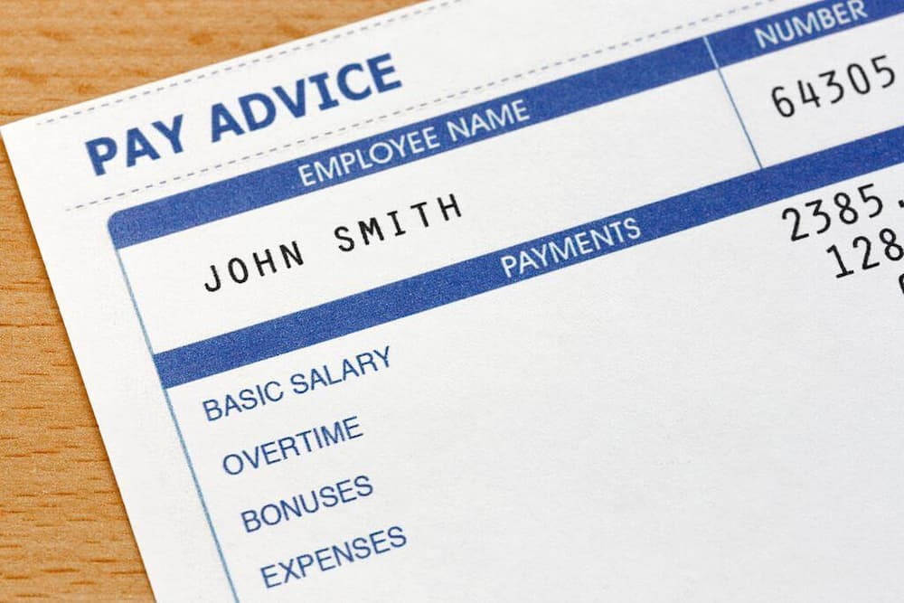
Payslip Study – some examples

Slide 25
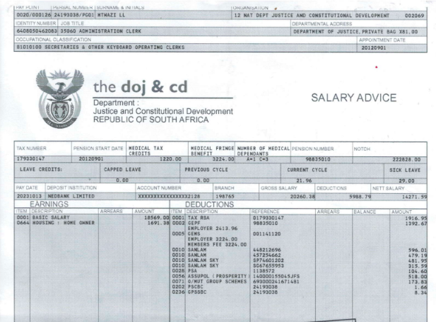
Mr X

Slide 26
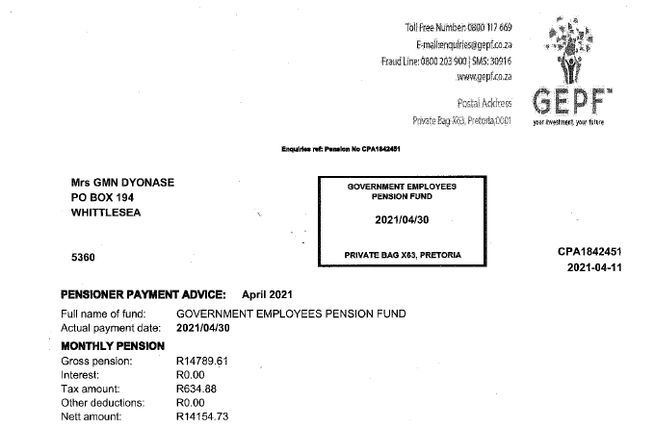
GEPF Earner

Slide 27
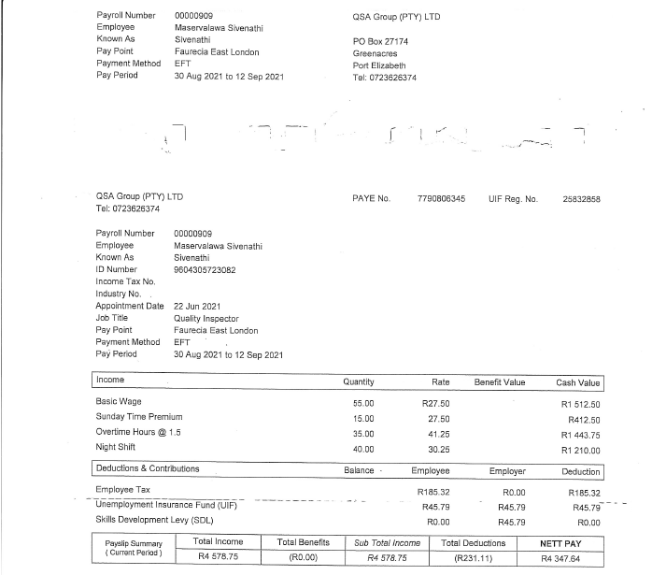
Employee Name

Slide 28
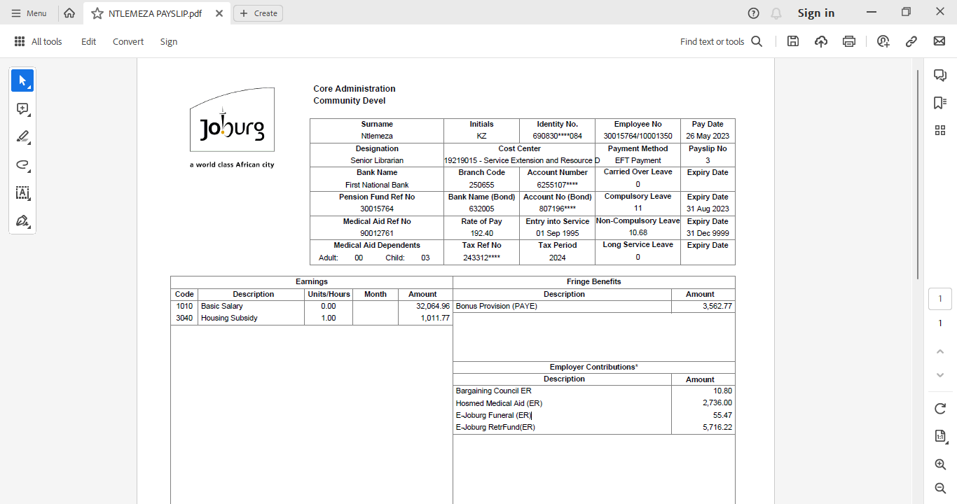

Slide 29
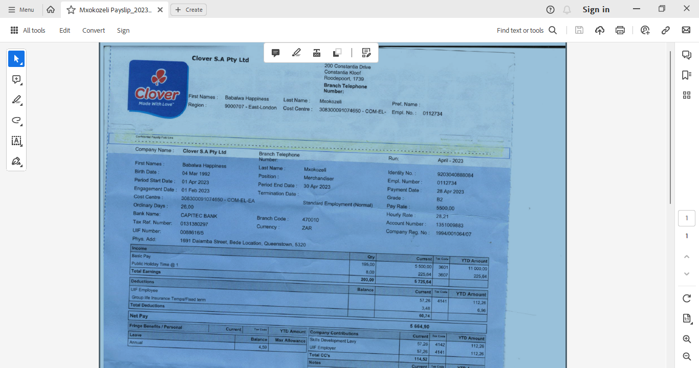

Slide 30
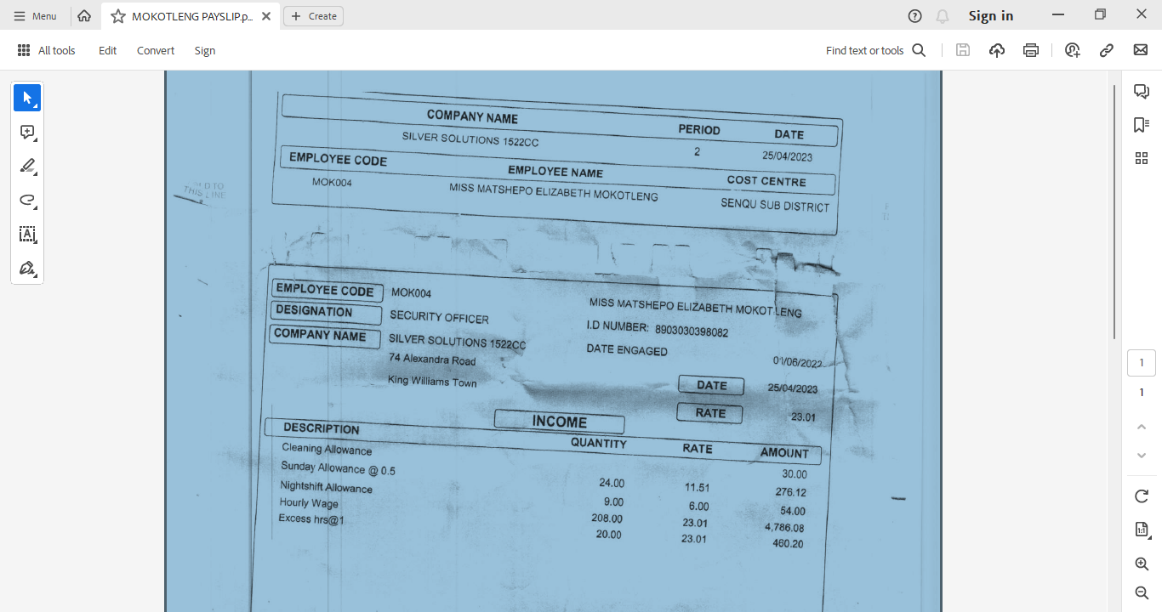

Slide 31
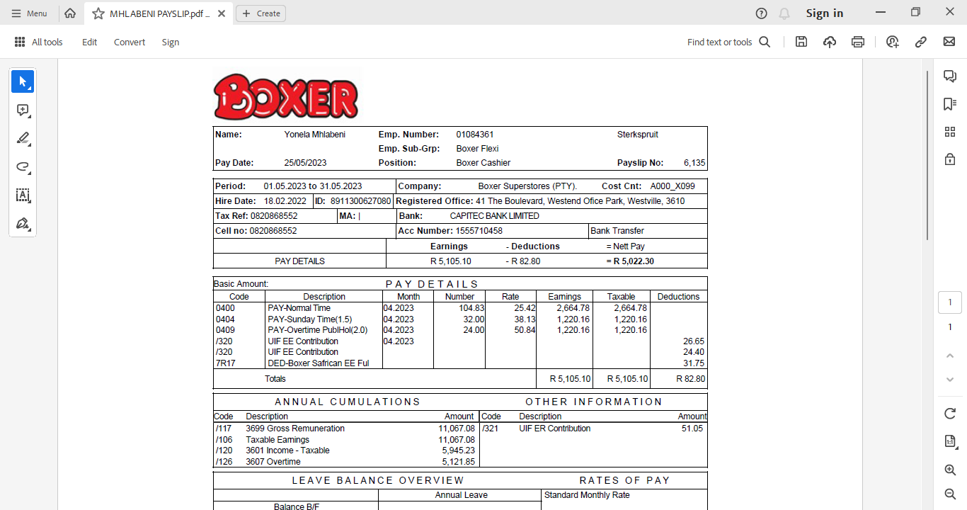

Slide 32
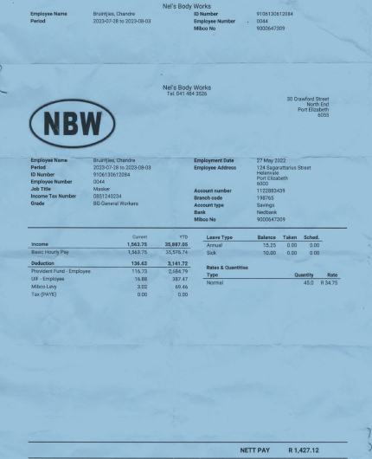
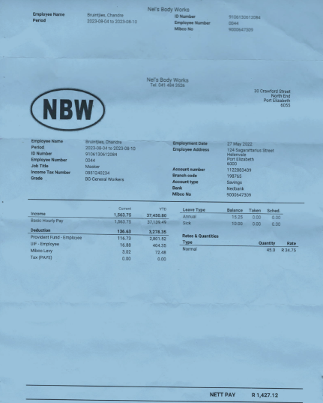

Slide 33
